Slide 1
MEU-UCMS STUDENTS’ FELICITATION AWARD

Slide 2
Disclaimer: This is in no order of merit.

Slide 3
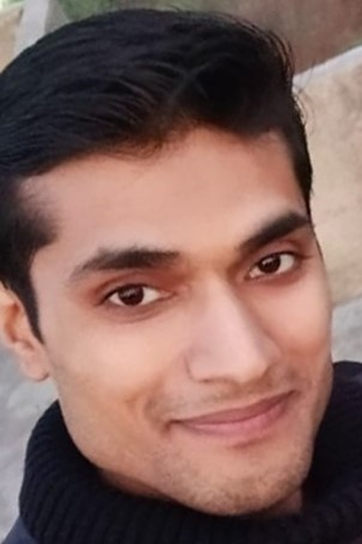
Entrusted with responsibility of being the first point of contact between college and new students post admission.
Verification and updating of UG student data.
Individualised reach out to every student on behalf of MEU.
Guide to college and campus life; necessities’ sensitization and alleviation of queries.
Sharing lived experience of M.B.B.S. life at U.C.M.S.
Foundation course class coordination, attendance & feedback.
Handling official WhatsApp group of UG 2020 batch.
Coordinating MS Teams platform usage by faculty & students.
Counselling to students in need during COVID-19.
Troubleshooting academic and campus issues.
Dr Vivek Kumar
PG-2 (Physiology)

Slide 4
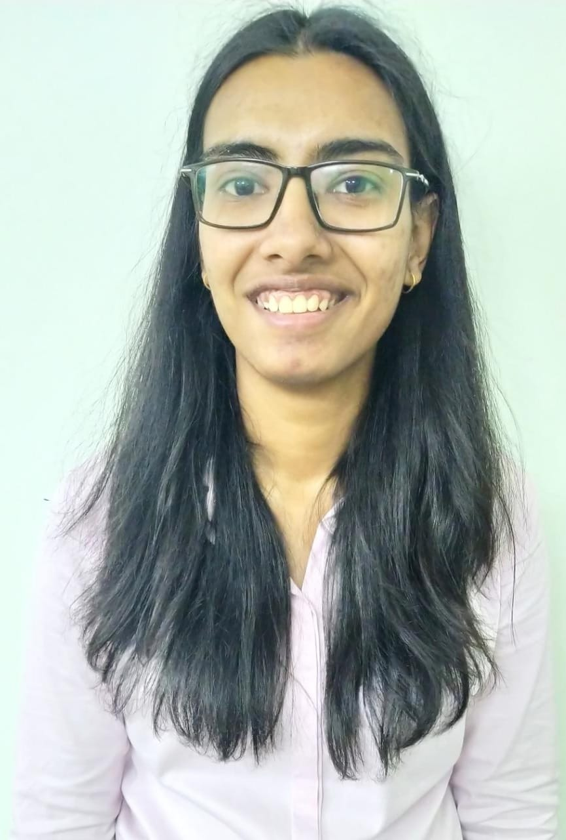
Kamakshi Bansal, Batch 2017
ACHIEVEMENTS
Conducted a workshop on Research Methodology including PubMed and Mendeley. UCMS, Delhi. Oct 12, 2019 and Sep 21, 2019.
Mentor, Mentor- Mentee Program, UCMS. Sep 2018-Present
Delegate, 74th WHO South-East AsiaRegional Committee Meeting. Nepal. Sep 6-13, 2021.
Medical Volunteer, Dhanwantri Seva Yatra by NMO (Rural Health Camps), Meghalaya. Feb 2021.
Organiser, International Geriatric Debate Competition. Jan-Feb, 2021.
Coordinator for Certificate Workshop on Biomedical Statistics 2 for Faculty. Jan-Mar, 2021
Presentation on Correlation Statistics in Certificate Workshop on Biomedical Statistics 2 for Faculty. Jan 27, 2021.
Represented India in an international webinar on Age Friendly Universities. Zoom. Sept 7, 2020.
Have coordinated and organised multiple National and international workshops, conferences, events and held multiple positions of responsibilities at both national and international platforms.
RESEARCH EXPERIENCE:
5 Publications, STS ICMR 2019, 2 International Presentations

Slide 5
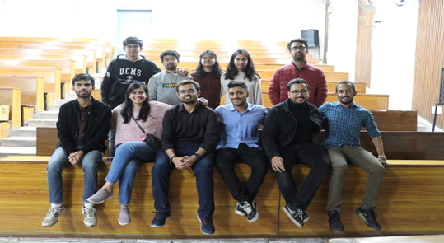
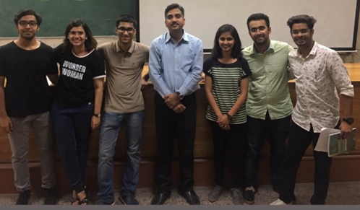
Chetna Dengri, MBBS
Founder, Illuminous- The Medical Quiz Association
Event Coordinator, Primer on Research Workshop

Slide 6
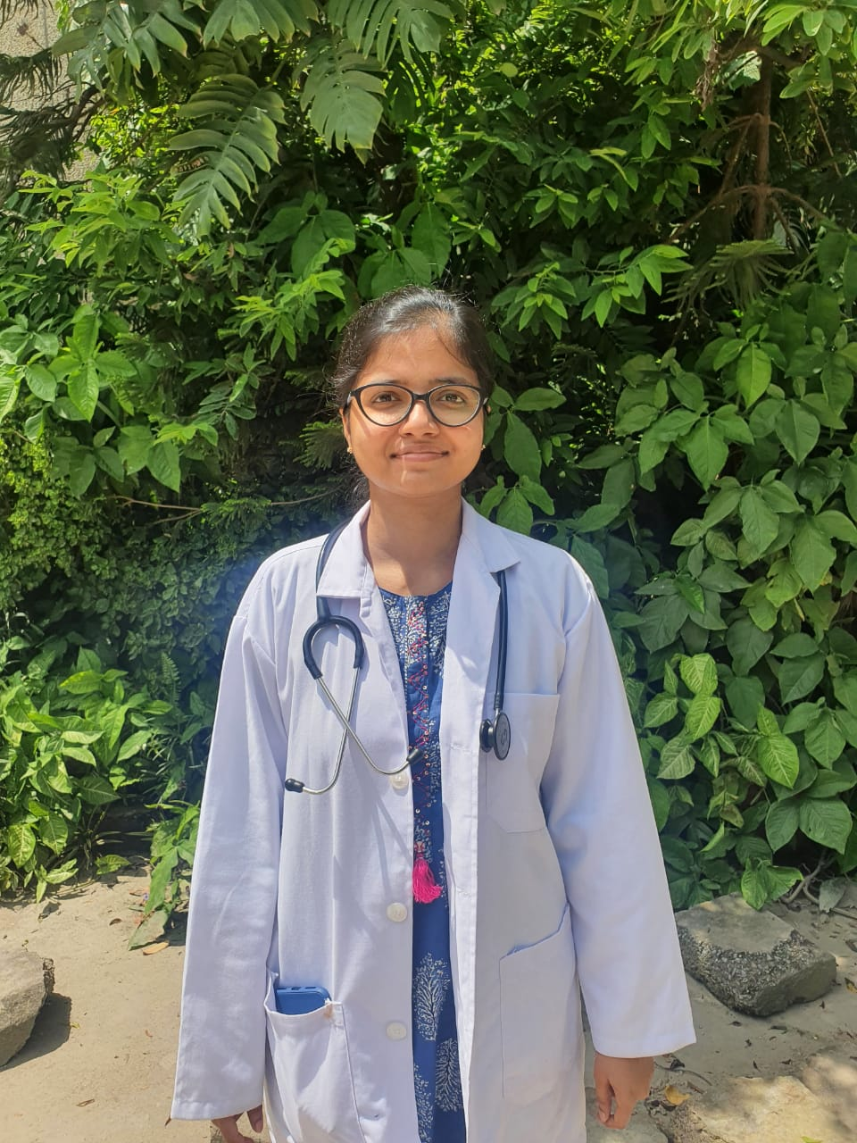
Distinctions in Microbiology, Pharmacology, Pediatrics
Senior Co-ordinator, Illuminous (2018-2021), quizmaster in more than 10 national and international level medical quizzes.
1st Prize in GAIMS Global Health Conclave (GHC) 2021
1st Prize in Surgery Quiz in ‘Surgicon-2019’ at AIIMS, Delhi.
1st Prize in Physiology Seminar for the Best Speaker, at UCMS Delhi, 2016.
1st Prize in college-round of IAP quiz 2020
1st prize in ‘Dr. House’ quiz organized by CMC, Calicut and DAMS, 2020
1st Prize in Quarantinoma Quiz organized by LHMC, Delhi, 2020.
1st Prize in ‘Does your GreyMatter?’ quiz organized by Illuminous, UCMS Delhi, 2020
2nd Prize in divisional-round of IAP quiz 2020
2nd Prize at Medillectuals Senior Quiz in Medsicon, VMMC 2019.
2nd Prize in ‘Brainstorm Clinical Quiz- I’ organized by MGT and SAMSA (2020)
2nd Prize in ‘Anat-mosis-The anatomy quiz’ organized by NMO, Delhi (2020)
2nd Prize in ‘Brainstorm Clinical Quiz- II’ organized by MGT and SAMSA(2020)
2nd prize in medical Quiz, conducted by DAMS at UCMS, Delhi.(2019)
3rd Prize in Pathology Quiz organized by GAIMS and DBMCI , Delhi.(2020)
4th prize in Pathology Quiz organised by Elsevier at ACMS, Delhi (2019)
Articles:
Delivering care with competency during COVID-19 pandemic: Experience of an intern working at a COVID facility: Elsevier student bulletin
Researchwork:
Clinics but no clinical training: Decoding the impact of COVID-19 lockdown on Indian medical undergraduates.
(Work in progress)
Dr. Meemansa Jindal
2016 batch

Slide 7
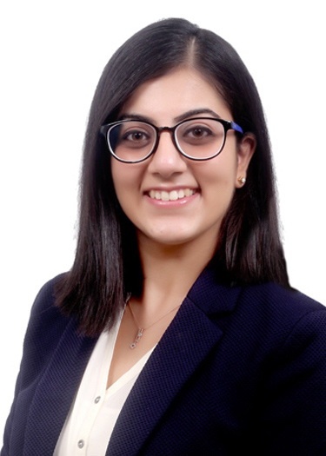
Mentor for junior medical students from 2nd year till now: Helping them academically, and with their career aspirations.
Authored and contributed to numerous publications in the form of original research articles, case reports, review article in the Departments of Medicine, Pediatrics, Pathology, and Community Medicine.
Member, Curriculum Committee: Chosen as the student representative: Provided a student’s perspective for the evolving medical curriculum for younger medical students.
Member of the UCMS Dance team (Renaissance) and Quiz society (Illuminous).
Ujjwal Madan
Mbbs Batch 2014

Slide 8
USTAT KHULLAR
Contributions :-
Created a website – www.bookeshi.com to help medical students find free educational resources.
Created a Youtube Channel – Bookeshi – Science for the same purpose as the website

Slide 9
Shreyansh Gadi
Class Representative (2017 batch)
Coordinated online classes

Slide 10
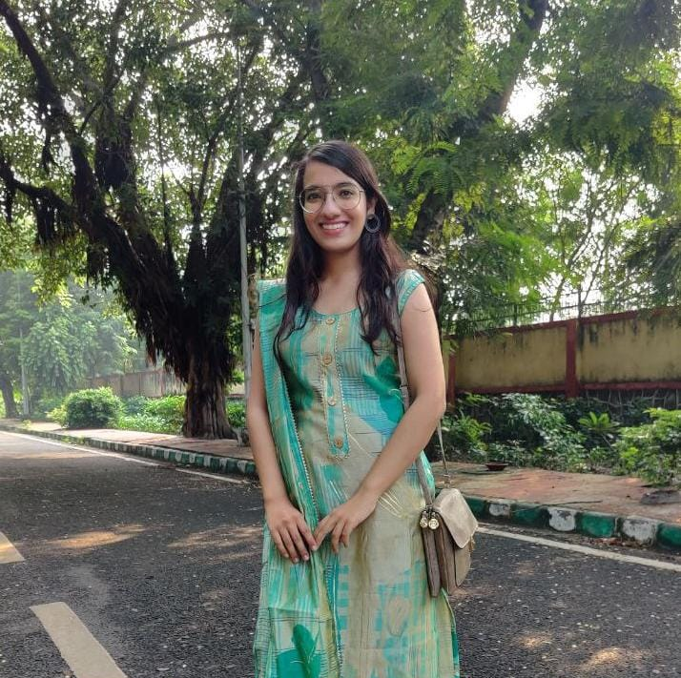
Anukriti Kaushik
Class Representative (2017 batch)
Co-ordinated online classes

Slide 12
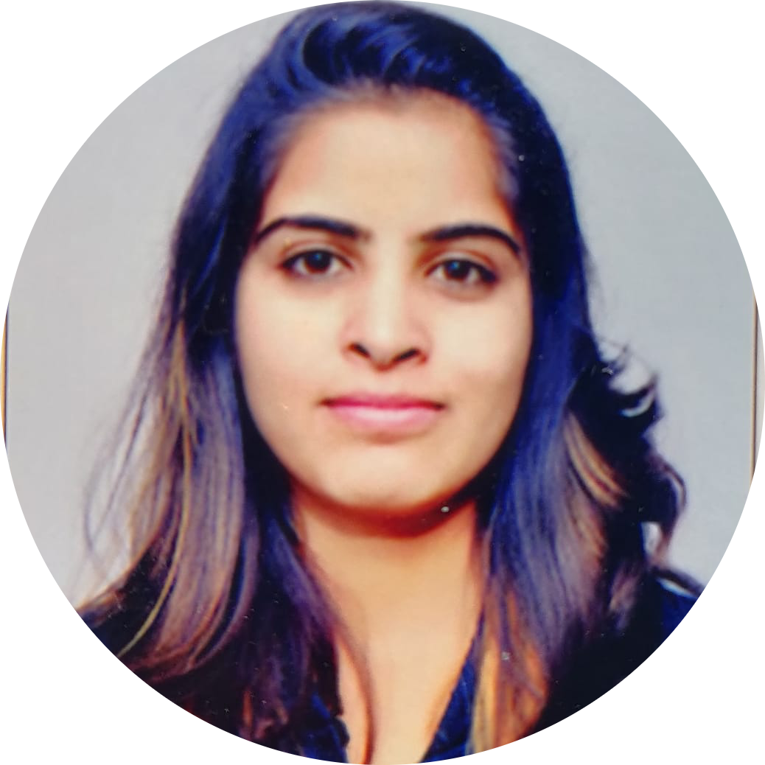
Dr. Abhilasha Kapoor, MD
Community Medicine
Contributed by creating transcript for “Disability-inclusive compassionate care: Disability competencies for an Indian Medical Graduate”.
Prepared step-wise modules on Epi Info version 7 for sample size calculation and basic and advanced statistical tests.
Prepared an educational website “Stethcalc” for the easy access of these modules. (So far, 85 people from different medical institutions of India have registered)
Prepared “COVID-19 guidelines for vulnerable groups & caregivers” with Chronic Pain India

Slide 13
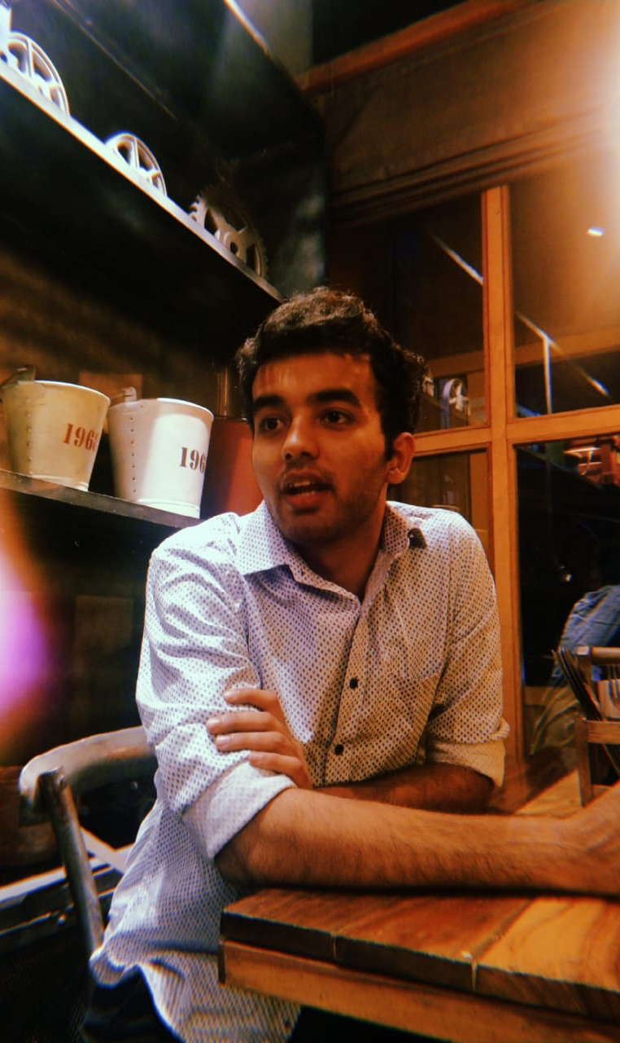
My enthusiasm and commitment towards research stems from my interest in finding novel ways to alleviate the morbidity associated with chronic illnesses. I have been working in several areas like cardiovascular diseases, neurological disorders, COVID-19, mesenchymal stem cells, anti-microbial resistance etc. Moreover, I have developed an interest in Computational Neuroscience with device innovation. Additionally, I was awarded the ICMR STS 2020 project under the mentorship of Prof. (Dr.) S.B. Sharma. I have developed in-depth knowledge about research protocol, methodology and ethics via several online and offline courses including Biostatistics and R specialization from Johns Hopkins University, Introduction to Principles and Practices of Clinical Research from National Institute of Health and Health Research from National Institute of Epidemiology. I have been working with national and international collaborators as a consequence of which I have published one systematic review and completed a few more manuscripts which are under process in high impact factored journals of repute. I am a certified Web of Science peer reviewer and am currently working as a trainee in Cochrane. I am also a mentor in international level peer mentoring programs where the aim is to provide mentorship to new researchers. I believe in spreading the culture and hence plan on birthing a similar scientific society in our college under the guidance of our respected faculty members which would promote peer-based teaching through which we can achieve something substantial.
Amaan Javed (2019 Batch)

Slide 14
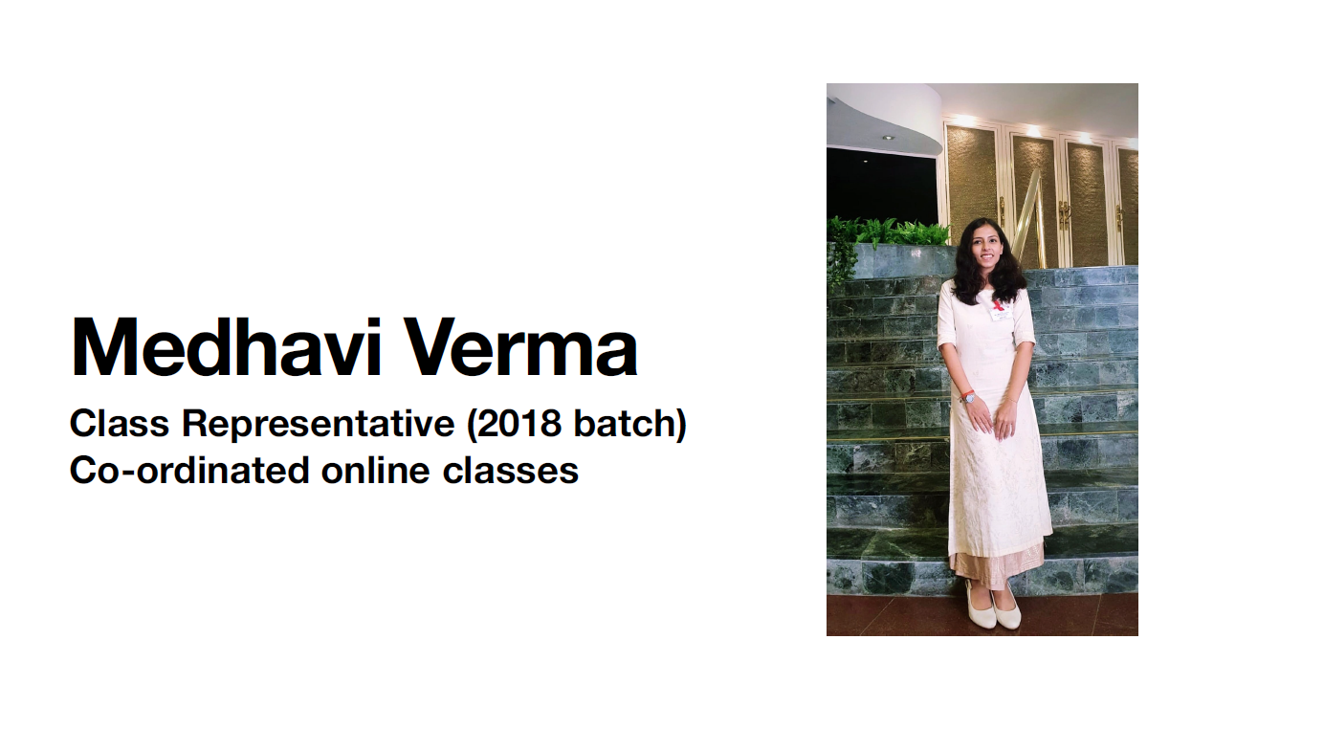

Slide 15
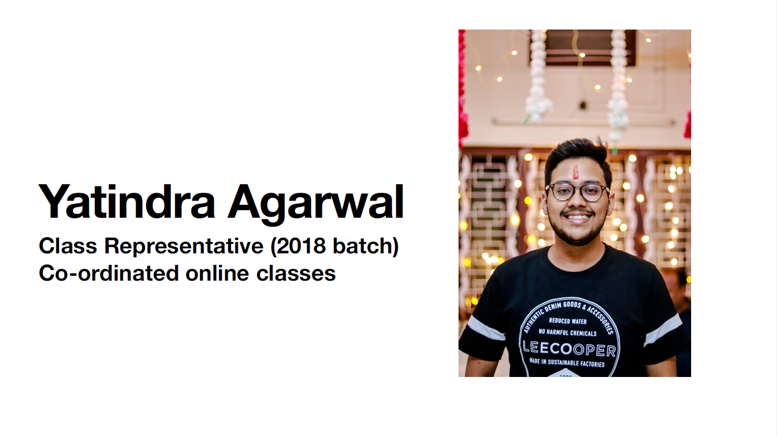

Slide 16
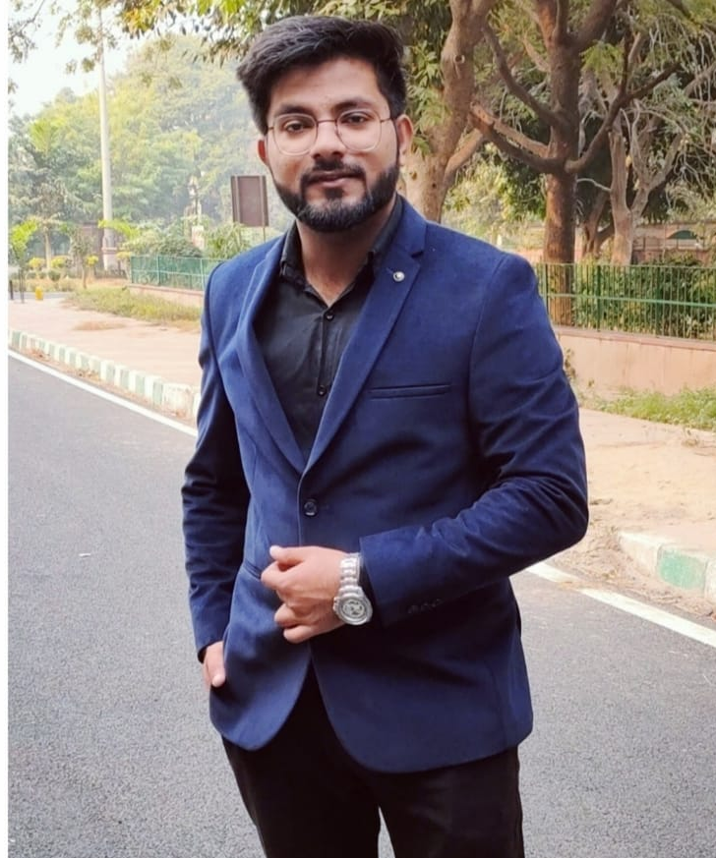
Baqar Riyaz Batch-2019
Contributions :
- Created a Youtube Channel to Help Pre-Medical (NEET UG) Aspirants in October 2020 which now has over 56,000 subscribers with 100+ uploaded videos.
- Also working as the Head of NEET Mentorship program in an online coaching with 55 Lakhs Subscribers on YouTube.
- Managing 3 Whatsapp Groups to Guide 700+ 1st Year MBBS students from All the Medical Colleges of Delhi.

Slide 17
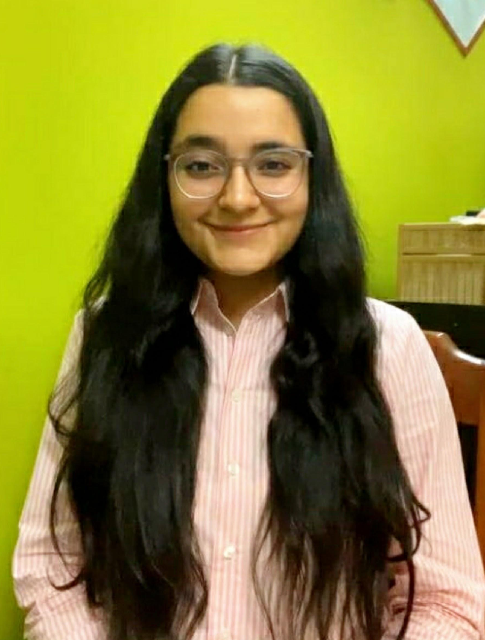
Maanya Mehra
Coordinator, Organum Donum, Organ Donation awareness society of University College of Medical Sciences and GTB Hospital, Delhi
Organised various events to spread awareness regarding organ, blood and tissue donation-
ELIXIR: A concoction of knowledge, Quiz competition
ZEST: Debate competition
INSIGHT: Open mic
MRITYUNJAY: A tribute to the deceased, Microtale and skit competition
Part of Guest Lecture by Dr. Anupam Sibbal on Pediatric Liver Transplantation in low income settings

Slide 18
Hansika Garg
She was the coordinator of ORGANUM DONUM society and has organized many events to spread awareness with the team.
Organised Organum Quizzards, quiz on organ donation (2020)
UCMS 2020 batch induction session
Organised Blood and plasma donation seminar (2021)
Organised Elixir, quiz on organ donation (2021)

Slide 19
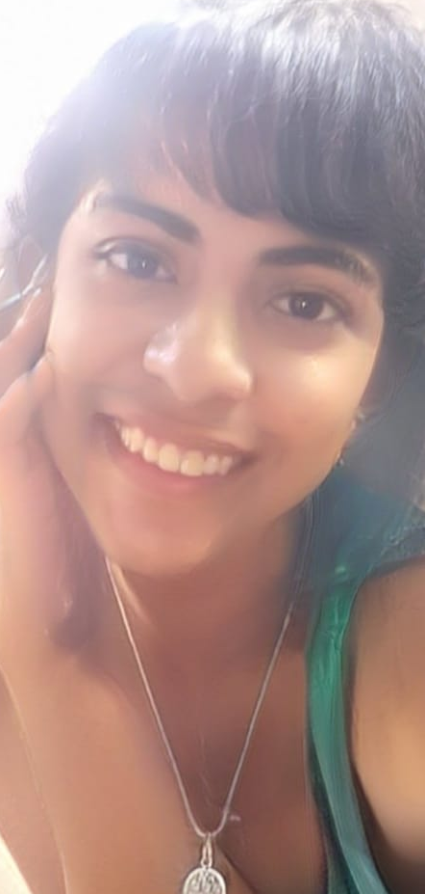
Bhavya Pahwa
Conducted National Level Medical Quizzes as ILLUMINOUS Coordinator.
Founder- IRIDESCENCE, India’s first LGBT Promoting Club in any medical institution.
Youngest Founder President- WALTER E DANDY Neurosurgery Club, India- prompting neurosurgical education amongst medical students and providing them with research opportunities in neurosurgery.
General Secretary for MSFC-Medical students for Choice: Awaring medical students and patients about abortion and related issues.
National Director for SRESOG, GAIMS- Promoting Sexual and reproductive health education amongst medical students.
Teaching medical students research and helping them with publications.
Published 4 research articles, working on more International publications and worked on 3 book chapters.
Won a grant of $ 15,000 at the OHSU Post Hack. April, 2021 for my project on Diabetic Peripheral Neuropathy.
3rd Prize- OHSU Invent-a-thon organised by Oregon Health & Science University in partnership with MIT Hacking Medicine and Microsoft, For my project on Early Diagnosis of Diabetic Peripheral Neuropathy
Winner-MIT Hacking Racism Challenge organised by Massachusetts Inst. Of Technology, USA. For my project on A Screening app for Obstructive Sleep Apnea.
Winner- MIT COVID 19 Challenge organised by Massachusetts Inst. Of Technology, USA. For my project “VACCINATE INDIA”

Slide 20
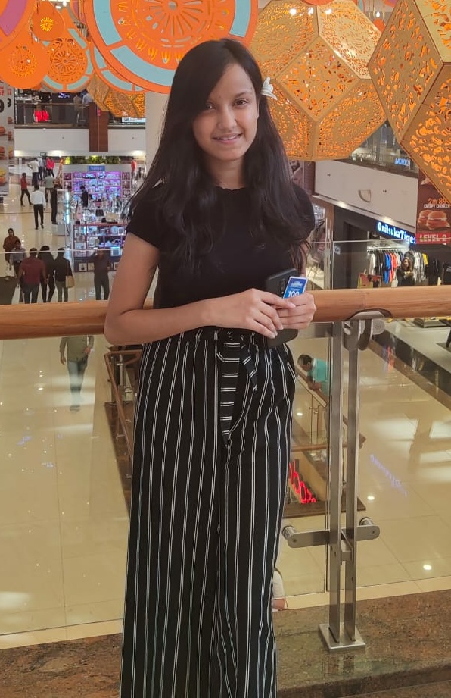
HARSHITA SINGHAL, Batch 2019
Managed social media for ILLUMINOUS (2k+ followers)
Conducted an intracollege medical quiz for the batch 2020
Conducted various events for ORGANUM DONUM
Did a research internship
Worked for GAIMS, Sexual and Reproductive Health Awareness Committee
Medical content writing for an NGO

Slide 21
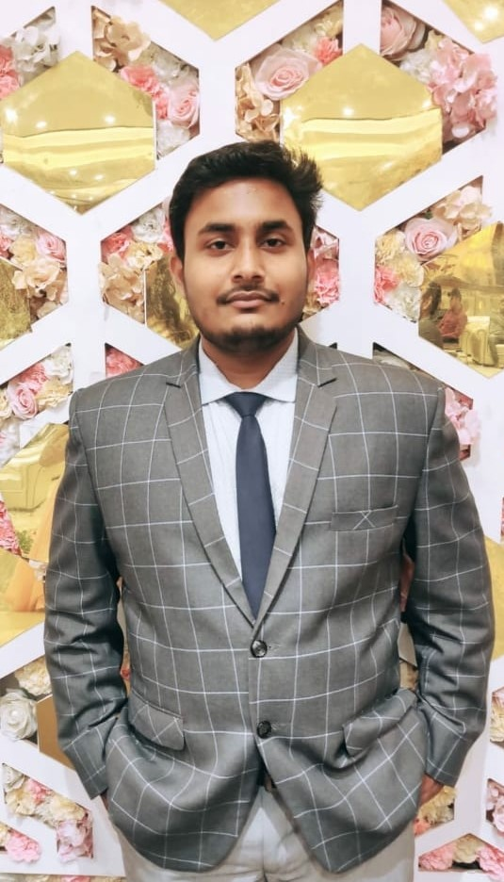
Afzal Parvez Khan (MS-II)
RESEARCH PRESENTATIONS:
Presented a case report titled ‘Non-Hodgkins Lymphoma presenting as acute abdominal discomfort and generalized lymphadenopathy’ in Global Health Conference 2021.
PUBLICATIONS:
Non-Hodgkins Lymphoma presenting as acute abdominal discomfort and generalized lymphadenopathy: A Case report abstract published in the Global Journal of Medical Students (GJMS).
VOLUNTEER WORK:
I.T. Head Organum Donum
Organised many events of organ donation awareness like quizzes, competitions etc.
Volunteer in UCs’ Paws: Sterilization and vaccination of the campus dogs.
Promoting Medical Education and Research with th help of different organisations like Asian Medical Students Association (AMSA), Medical Students’ Association of India (MSAI) and Indian Academy of Geriatrics Student Chapter (IAGSC).

Slide 22
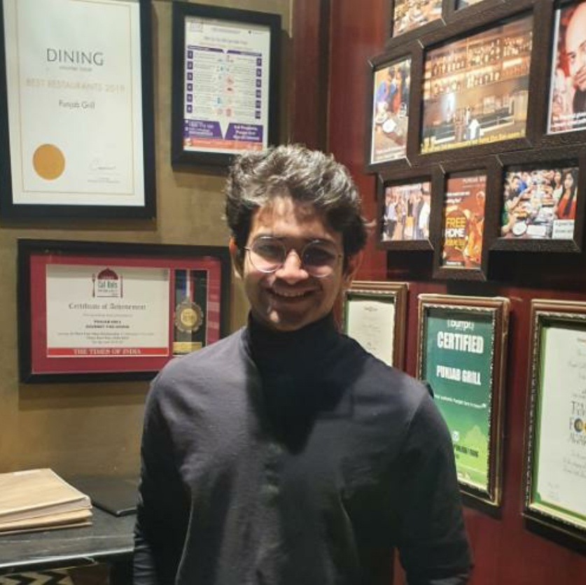
DHRUVA GUPTA, Batch 2019
Managed social media for Illuminous, the quizzing society
Conducted and hosted various events for Organum Donum.

Slide 23
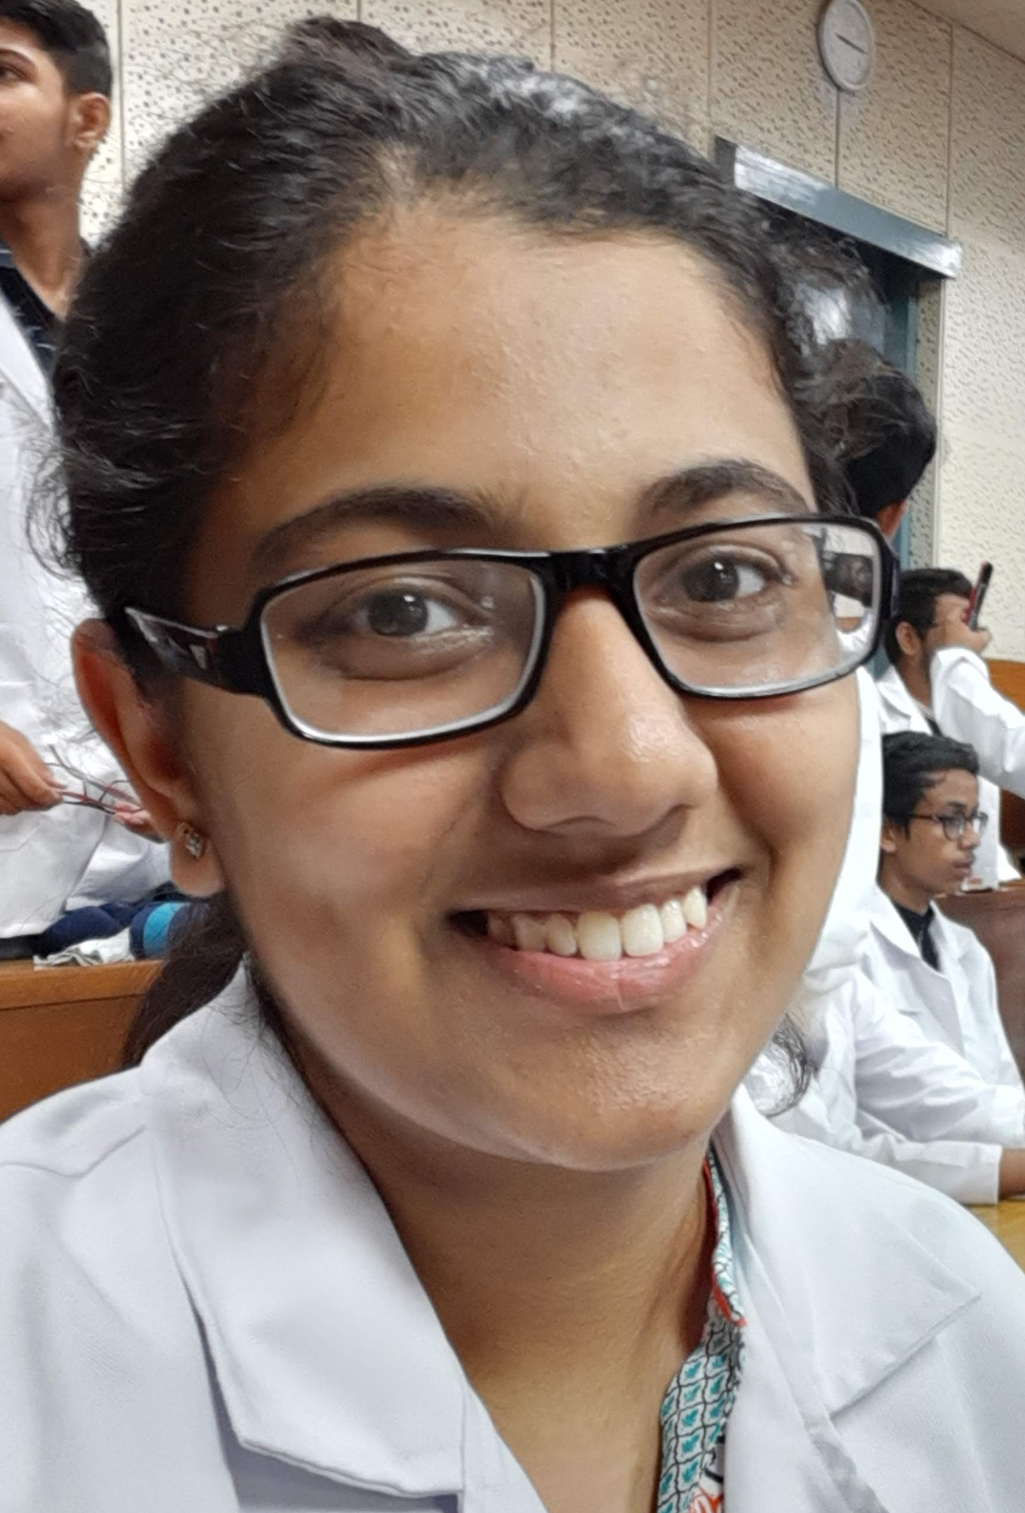
Shruti Teotia
Class Representatives of 2019 Batch.
Aided to co-ordinate online Lectures and Assessment between teachers and students .

Slide 24
Manya Gupta
Co- coordinator, Organum Donum, Organ Donation
Awareness Society of University College of Medical Sciences
& GTB Hospital, Delhi.
Organised various events to spread awareness regarding
organ, blood and tissue donation:
● ORGANUM QUIZZARDS, quiz competition
● Freestyle Creativity Competition on theme ‘Organ
Donation’
● Webinar on “Blood & Plasma Donation Drive”
● ELIXIR: A Concoction of Knowledge, quiz competition
● MRITYUNJAY: A Tribute to Deceased, Microtale and
Skit competition
● Part of Guest Lecture by Dr. Anupam Sibbal on
Paediatric Liver Transplantation in Low Income settings

Slide 25
RESEARCH ORIENTED
Organized Research Methodology workshops for batch 2017,18 and 19.
Won 3rd prize in paper presentation at Medsicon 2019
ICMR APPROVED STS ARTICLE- Effects of mobile phone usage
on cognition and sleep patterns in adults
ORGANUM DONUM
Coordinator of Organum Donum for year 2018-20
Organized an Organ Donation symposium at Swami Dayanand in 2018
Held Organ donation lecture for batch 2018 and 2019
Held the cadaveric oath during the foundation course of Batch 2019
COLLEGE ORIENTED
Help streamline and organize online teaching in Covid Era
Part of the Souvenir team for Golden Jubilee year, Annual Day 2021
Organized Alumni Sports Day in 2019
Organized online Fest, The Covid Contact 2020
Organized Arena, The sports week of UCMS 2019
Organized Farewell for Batch 2014
Dr. Ramansh Bandhu Gupta
Batch 2016
President, Students Union
(2019-21)

Slide 26
Acknowledgement
Dr Satendra Singh
Dr Ashish Goel
Dr AK Sharma
Dr Navjeevan Singh
Dr Upreet Dhaliwal

